Slide 1
Support Vector Machine
By
Bharath Karthick

Slide 2
Support Vector machine
SVM is go-to for High performance with little tuning.
It is one of the most popular Supervised Learning algorithms, which is used for classification as well as regression problems.
The SVM algorithm helps to find the best line or decision boundary, called hyperplane that classify the data points .
In SVM, a hyperplane is selected to separate the points in the input variable space by their class, with the largest margin.

Slide 3
Types of SVM
There are two different types of SVMs, each used for different things:
L SVM: Typically used for linear regression and classification problems.
Linear SVM is used for linearly separable data, which means if a dataset can be classified into two classes by using a straight line , then such data is termed as linear separable data and classifier is called as Linear SVM Classifier.
NL SVM: Has more flexibility for non-linear data because you can add more features to fit a hyperplane instead of a two-dimensional space.
Non-Linear SVM is used for non-linearly separated data, which means if a dataset cannot be classified by using a straight line, then such data is termed as non-linear data and classifier used is called as Non-linear SVM classifier.

Slide 4
Hyperplane
Hyperplanes are decision boundaries that help classify the data points. Data points falling on either side of the hyperplane can be attributed to different classes. Also, the dimension of the hyperplane depends upon the number of features. If the number of input features is 2, then the hyperplane is just a line. If the number of input features is 3, then the hyperplane becomes a two-dimensional plane. It becomes difficult to imagine when the number of features exceeds 3.

Slide 5
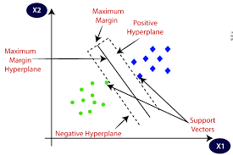

Slide 6
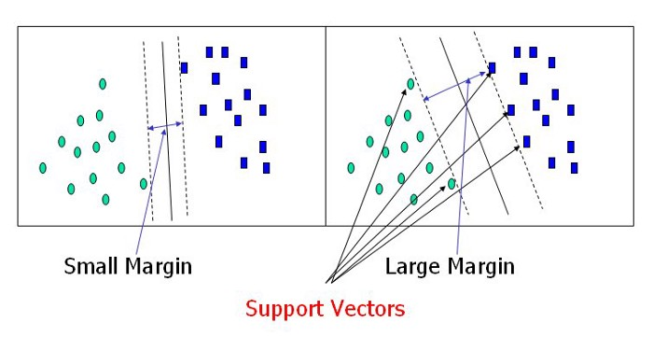
Support Vectors
Support vectors are data points that are closer to the hyperplane and influence the position and orientation of the hyperplane. Using these support vectors, we maximize the margin of the classifier. Deleting the support vectors will change the position of the hyperplane. These are the points that help us build our SVM.

Slide 7
Margin
The distance between the support vectors is called as margin and the goal of SVM is to maximize this margin.

Slide 8
Kernel Trick/Kernel Function
.Kernel Function generally transforms the training set of data so that a non-linear decision surface is able to transformed to a linear equation in a higher number of dimension spaces.
A kernel transforms a low-dimensional input data space into a higher dimensional space. So, it converts non-linear separable problems to linear separable problems by adding more dimensions to it. Thus, the kernel trick helps us to build a more accurate classifier. Hence, it is useful in non-linear separation problems

Slide 9
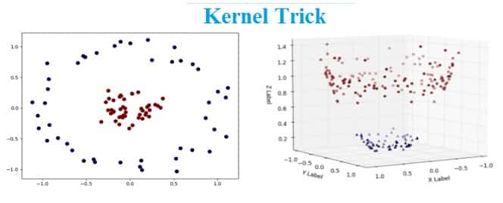

Slide 10
Radial Basis Kernal
Radial Basis Kernal :
It is a general-purpose kernel; used when there is no prior knowledge about the data.
The RBF kernel function for two points X₁ and X₂ computes the similarity or how close they are to each other.
RBF Kernel is popular because of its similarity to K-Nearest Neighborhood Algorithm. It has the advantages of K-NN and overcomes the space complexity problem as RBF Kernel Support Vector Machines just needs to store the support vectors during training and not the entire dataset.

Slide 11
Pros and Cons of SVM
Advantages of Support Vector Machine
Training of the model is relatively easy
The model scales relatively well to high dimensional data
SVM is a useful alternative to neural networks
Trade-off amongst classifier complexity and error can be controlled explicitly
It is useful for both Linearly Separable and Non-linearly Separable data
Assured Optimality: The solution is guaranteed to be the global minimum due to the nature of Convex Optimization

Slide 12
Disadvantages of SVM
Picking right kernel and parameters can be computationally intensive
In Natural Language Processing (NLP), a structured representation of text yields better performance. However, SVMs cannot accommodate such structures(word embedding)

Slide 13
Applications of SVM
There are various applications of Kernel trick few of them are
Geostatistics: It is a branch of statistics concentrating on spatial or spatiotemporal datasets. It was originally created to predict the probability distributions of ore grading at mining operations. Now it is applied in diverse disciplines including petroleum geology, hydrogeology, hydrology, meteorology, oceanography, geochemistry, geometallurgy, geography, forestry, environmental control, landscape ecology, soil science, and agriculture (specifically in precision farming).
Inverse distance weighting: Type of deterministic method for multivariate interpolation with a known scattered set of points. The values assigned to unknown points are calculated with a weighted average of the values existing at the known points.
3D Reconstruction: Process of capturing the shape and appearance of real objects.

